Slide 1
A Better Disaster Relief System
By Ananya Mehta
Grade 6
Non RRI
B17
https://youtu.be/-2kOv2zzHsQ

Slide 2
Introduction
Goal
To create a disaster relief app that communicates needs from victims to the disaster relief agencies, without connection.
Purpose
Create a faster disaster relief system that could save more lives
Make a cost-effective search & rescue method
Automatic, asynchronous communication between victims and agencies

Slide 3
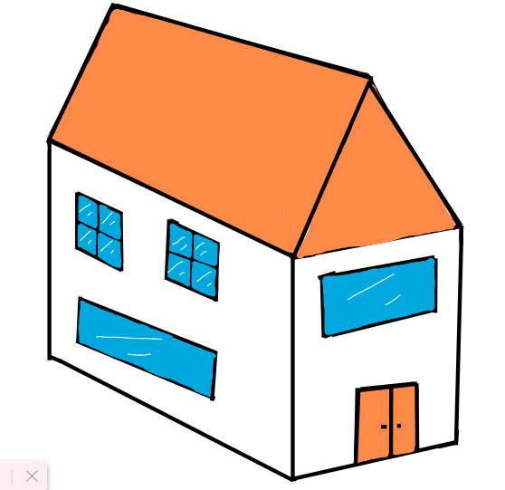
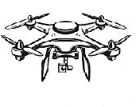
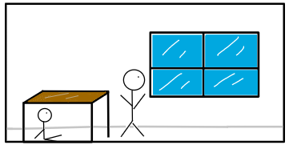
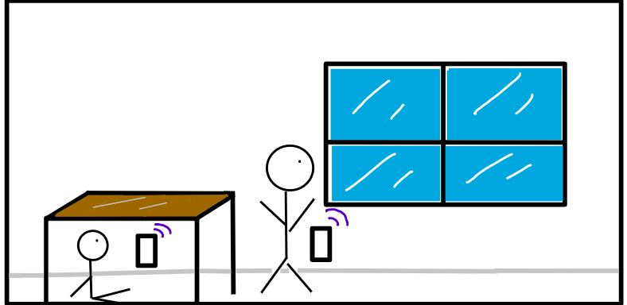
Introduction - Background Research
Natural disasters can create a tremendous amount of damage when it hits populated areas
Cell-phone towers might be down/unreachable
Victims can use Bluetooth to send information to drone flying overhead
Bluetooth does not require cellular data and is present in all smartphones
Electromagnetic waves can pass through objects
Standard Bluetooth has a range of about 10 meters
Can communicate through walls/roofs of houses, even multi-layered
The drones that disaster relief agencies currently use are line-of-sight drones. The person in the window is seen, but the person under the table is not.
With Bluetooth, both of the victims can communicate with the drone.

Slide 4
Methods - Success Criteria
Defines a standard way for people to communicate their emergency requirements, like food, water, etc. in less than 200 bytes of data
The tracker device (drone) should be able to collect emergency needs from 10 houses in 250 meters, in under 1 minute.
The tracker device should be able to communicate with 80% of the tag devices (smartphones) with or without line of sight.
The tracker and tag devices should be able to communicate without requiring internet or cell phone connection.

Slide 5
Methods - Design Constraints
We will need to use a drone that can carry a tracker device weighing up to 200 grams.
The disaster relief drone should be able to fly for a distance of at least 250 meters on a single charge.
A tag device will be enabled through an app on victim’s smartphones which should have at least 30% charge left.
Both the tag and tracker devices should have Bluetooth support. They do not need to have cell phone or internet connection.
Should be able to prototype the system within 6 wks.

Slide 6
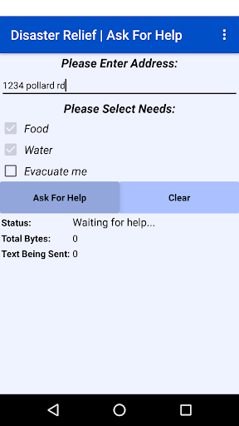
Methods
Testing Procedure
Open air and line-of-sight with tracker
Fill out the address, and needs on each tag device, and place phones in the backyard.
Walk around next to the phones with the tracker phone. Record results.
Open air and no line-of-sight with tracker
Fill out the address, and needs on each tag device, and place phones in the backyard.
Hide behind something (such as a thick tree or a shed) with tracker phone.
Record Results.
Enclosed space and no line-of-sight with tracker
Fill out the address, and needs on each tag device.
Place the phones inside your house, and stand outside (make sure that there are no open doors or windows close-by.
Record Results.

Slide 7
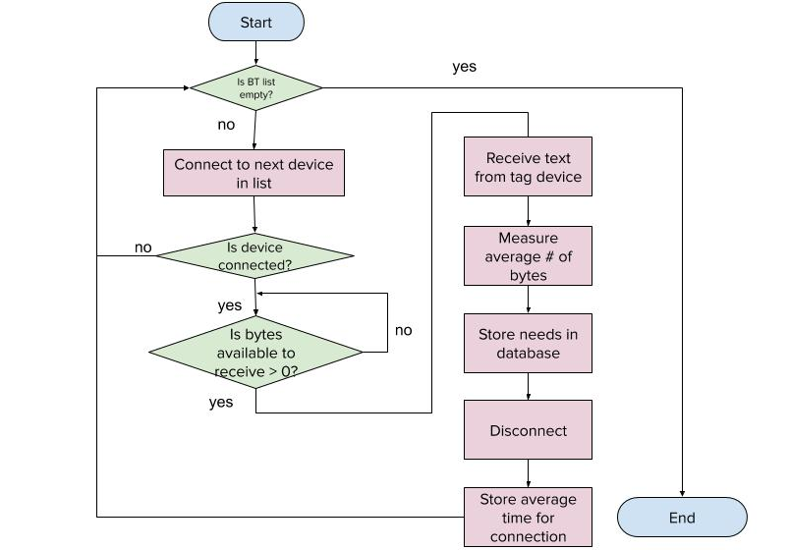
Methods
Used MIT app inventor
Tag
Made sure it was able to connect to tracker
Got it to send needs
Made interface a bit easier to use
Tracker
Made sure it was able to connect to tags
Made it go through every single tag and try to recieve needs, then disconnect
Designed storage to store all of them
Added some more interface to show data needed for testing

Slide 8
Results
Trial # Tag devices in open air, and in line of sight with the tracker device | Number of tag devices able to communicate needs | Average time taken to send data (ms) | Average number of bytes taken to send needs
Trial 1 | 10/10 | 813 | 58.5
Trial 2 | 10/10 | 731 | 38.6
Trial 3 | 10/10 | 795 | 25.6
AVERAGE | 10 | 779.6666667 | 40.9
Trial # Tag devices in open air, and no line of sight with the tracker device | Number of tag devices able to communicate needs | Average time taken to send data (ms) | Average number of bytes taken to send needs
Trial 1 | 10/10 | 837 | 26.4
Trial 2 | 10/10 | 827 | 25.6
Trial 3 | 10/10 | 839 | 26.3
AVERAGE | 10 | 834.3333333 | 26.1

Slide 9
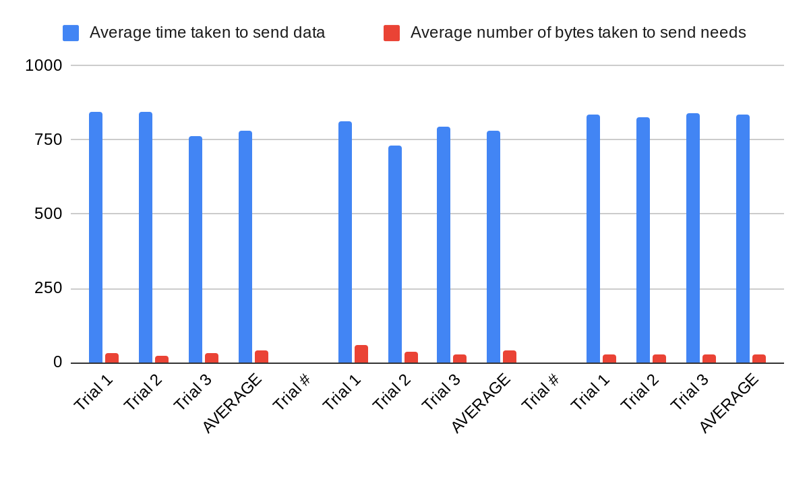
Results (contd.)
Trial # Tag devices in enclosed space, and no line of sight with the tracker device | Number of tag devices able to communicate needs | Average time taken to send data (ms) | Average number of bytes taken to send needs
Trial 1 | 10/10 | 843 | 33.6
Trial 2 | 10/10 | 845 | 22.3
Trial 3 | 10/10 | 762 | 30.3
AVERAGE | 10 | 779.6666667 | 40.9
Line-of-sight communication time is slightly faster at 780 ms average, compared to non line-of-sight average of 830 ms.
On average, most victim’s location information and their most urgent needs can be sent by tag app within 40 bytes

Slide 10
Discussion
The results made me confident my solution could be used for victims outside their homes as well as those trapped within. This is reliable, and a quick way to collect various needs from a neighborhood.
I faced some issues in using “device discovery” function on the tracker app to find tag devices, due to a bug in the software. So I had to use the pairing method instead.
Current solutions use line of sight to identify victims and needs. My prototype works in non line of sight conditions. It is also faster to use Bluetooth connection to quickly assess needs of many homes within minutes. People can get help faster, wherever they are, making it a lot more useful.

Slide 11
Conclusion
Since this was my first time writing an app and using Bluetooth functions, I was not sure how reliable the prototype would be. It turned out better than I expected, showing high reliability and predictable results being able to connect, collect data and display it in my preferred format.
My application can be used by disaster relief agencies during floods, power blackouts, fires or any similar condition. An agency drone can perform the tracker app operation and collect accurate, quick information on urgent needs of people in a safe way.

Slide 12
Bibliography
BRIGHT SIDE. “How Bluetooth Works.” Youtube. 4 July 2019. 4 October 2020. https://www.youtube.com/watch?v=jzxZUJmOu3o
Content Development Team. “Bluetooth Communication Using MIT App Inventor.” Robo India. 19 May 2019. 4 October 2020. https://www.roboindia.com/tutorials/bluetooth-communication-mit-app-inventor/
51 Drones. “Mavic Mini, Mavic Air, Mavic 2 Pro - How much can they lift?.” Youtube. 28 Match 2020. 4 October 2020.
www.youtube.com/watch?v=FtVqMC5YJdk
Jojo. “Types of Drones – Explore the Different Models of UAVs.” Circuits TODAY. 3 February 2017. 4 October 2020.
https://www.circuitstoday.com/types-of-drones
MIT. “MIT App Inventor” MIT app inventor | Explore MIT app inventor. 2012. 3 October 2020.
http://ai2.appinventor.mit.edu/

